Slide 1
GeoSPARQL: an introduction
C. Métral
Semantic Web Technologies

Slide 2
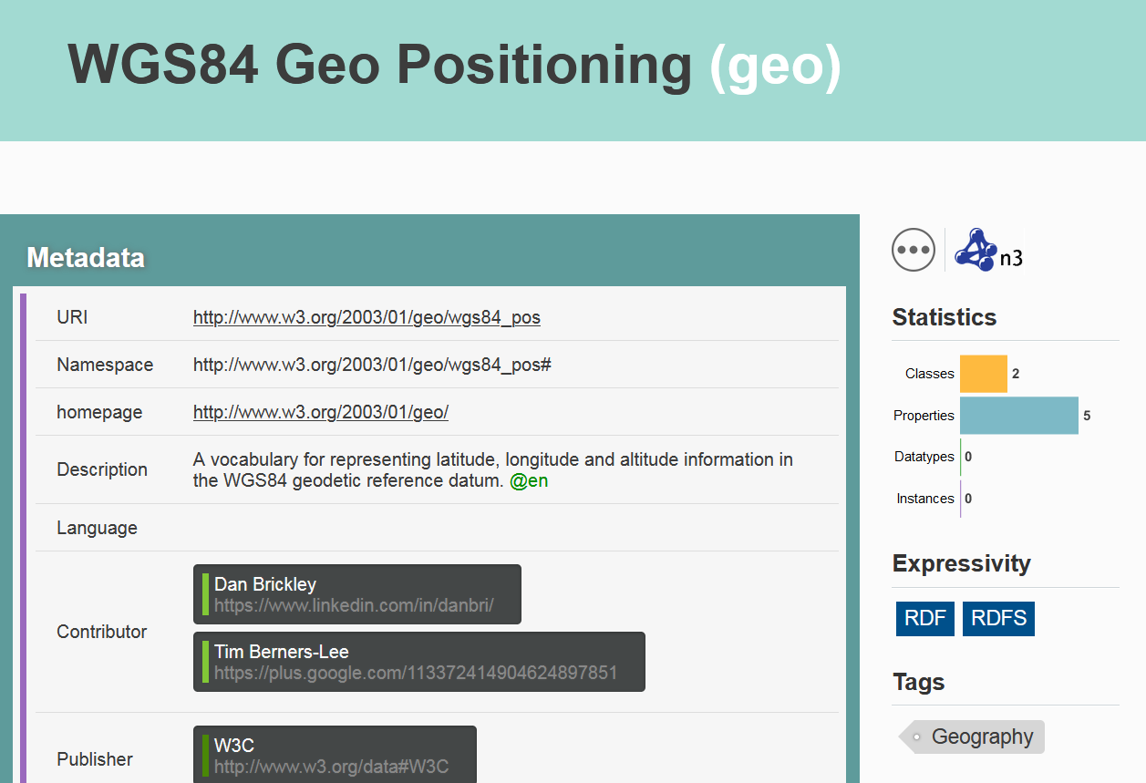
Representing Spatial Data
Available vocabulary, such as:

Slide 3
Handling Spatial Data
Need for spatial reasoning
Examples
What are the monuments in parks of Geneva?
What are the universities within 20 km?
What are the commercial land parcels that touch some arterial streets?
=> Need geospatial concepts and properties if the relationships (between monuments and parks or between parcels and streets) are not explicit

Slide 4
Handling Spatial Data with semantics
Examples
What are the monuments in parks of Geneva that have been made by Paul Landowski?
What are the universities within 20 km that propose courses on RDF?
=> Need RDF(S) + geospatial concepts and properties for representing such resources

Slide 5
Simple Features Model
Definition
It is a specification of the Open Geospatial Consortium, which defines a general architecture for geographic data and for their geometries
More precisely
It describes a way to represent geospatial data using a hierarchy of classes
It defines functions for accessing, operating and constructing these data
C. Métral
Semantic Web Technologies
5

Slide 6
Features and Geometries
Feature
Any entity in the real world with some spatial location
Examples: a university, a parcel, a street…
Geometry
Any geometric shape, such as a point, a line, a polygon, that is used as a representation of a feature’s spatial location
Examples: a point for a university, a polygon for a parcel…
Coordinate Reference System/Spatial Reference System
Part of the metadata associated with a geometry
Examples: (X,Y) coordinates, longitude and latitude…
C. Métral
Semantic Web Technologies
6

Slide 7
Topological relationships
Each spatial entity is inherently related to some other spatial entities -> 8 geospatial topological relations to describe relationships between entities in space
equals
disjoint
intersects at least one point in common (not disjoint)
touches at least one boundary point in common, but no interior points
within
contains inverse of within
overlaps
crosses
C. Métral
Semantic Web Technologies
7

Slide 8
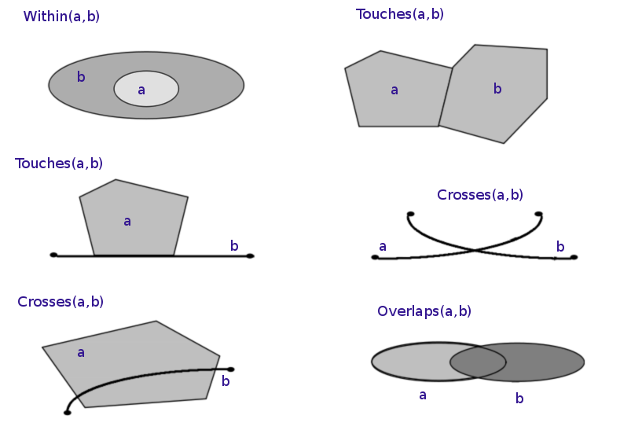
Examples of topological spatial relations
From http://en.wikipedia.org/wiki/Spatial_relation
C. Métral
Semantic Web Technologies
8

Slide 9
Handling and Querying Spatial Data
Examples
What are the universities within 20 km that propose courses on RDF?
What are the monuments in parks of Geneva that have been made by Paul Landowski?
=> Need of spatial reasoning with semantic reasoning
=> Need geospatial queries

Slide 10
GeoSPARQL
Definition
A spatial extension to the SPARQL query language for geospatial information
Built on existing standards
World Wide Web Consortium W3C Semantic Web: RDF, RDFS, SPARQL…
Open Geospatial Consortium OGC Simple Features model, geometry models…
ISO/TC 211
…
C. Métral
Semantic Web Technologies
10

Slide 11
GeoSPARQL
Provides the following features
An RDF/OWL vocabulary for representing spatial information consistent with the Simple Features Model
A set of SPARQL extension functions for spatial computations
A set of RIF (Rule Interchange Format) rules for query transformation
From [1]
C. Métral
Semantic Web Technologies
11

Slide 12
SPARQL query
What are the universities that propose courses on RDF?
…
@prefix cui: <http://cui.unige.ch/> .
SELECT ?i
WHERE {
?i a cui:University .
?i cui:course ?c .
?c cui:keyword ?k .
FILTER ( ?k = "RDF" )
}
C. Métral
Semantic Web Technologies
12

Slide 13
GeoSPARQL query
What are the universities within 20 km (from a reference point with lat=46.202 and lon=6.146) that propose courses on RDF?
…
SELECT ?i
WHERE {
?i a cui:University .
?i spatial:nearby(46.202 6.146 20 'km') .
?i cui:course ?c .
?c cui:keyword ?k .
FILTER ( ?k = "RDF" )
}
C. Métral
Semantic Web Technologies
13

Slide 14
Main geospatial classes and property
Spatial RDFS
Spatial Object
Feature
hasGeometry
Geometry
From [2]
C. Métral
Semantic Web Technologies
14

Slide 15
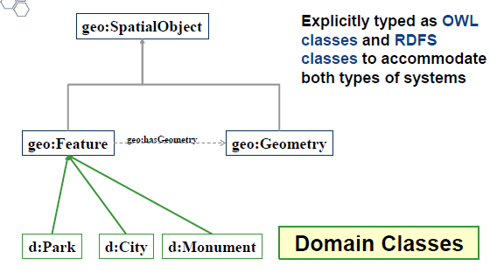
Geospatial and domain classes
From [3]
C. Métral
Semantic Web Technologies
15

Slide 16
Main geospatial classes and property
geo:Feature class A thing with a spatial location (a city, a monument…)
geo:Geometry class A representation of a spatial location (a set of coordinates)
geo:SpatialObject class A superclass of both Feature and Geometry classes
geo:hasGeometry property To link a feature to its geometry that represents its spatial extent A given feature may have many associated geometries for varying purposes Example: a city can be represented either by a point or a polygon according to the scale or to the size of the city See http://www.opengis.net/ont/geosparql
C. Métral
Semantic Web Technologies
16

Slide 17
Definition of geo:SpatialObject class
geo:SpatialObject a rdfs:Class, owl:Class;
rdfs:label "Spatial Object"@en;
rdfs:comment "The class Spatial Object represents everything that can have a spatial representation. It is superclass of feature and geometry"@en .
From [1]
C. Métral
Semantic Web Technologies
17

Slide 18
Definition of geo:Feature class
geo:Feature a rdfs:Class, owl:Class;
rdfs:label "Feature"@en;
rdfs:subClassOf geo:SpatialObject;
owl:disjointWith geo:Geometry;
rdfs:comment "This class represents the top-level feature type. This class is equivalent to GFI_Feature defined in ISO 19156, and it is superclass of all feature types"@en .
From [1]
Métral,
Semantic Web Technologies
18

Slide 19
Definition of geo:Geometry class
geo:Geometry a rdfs:Class,
owl:Class;
rdfs:label "Geometry"@en;
rdfs:subClassOf geo:SpatialObject;
owl:disjointWith geo:Feature;
rdfs:comment "The class represents the top-level geometry type. This class is equivalent to the UML class GM_Object defined in ISO 19107, and it is superclass of all geometry types"@en .
From [1]
C. Métral
Semantic Web Technologies
19

Slide 20
Definition of geo:hasGeometry property
geo:hasGeometry a rdf:Property, owl:ObjectProperty;
rdfs:label "has Geometry"@en;
rdfs:comment "A spatial representation for a given feature."@en;
rdfs:domain geo:Feature;
rdfs:range geo:Geometry .
From [1]
C. Métral
Semantic Web Technologies
20

Slide 21
Main geometry representations
WKT (Well-known text) Text markup language for representing vector geometry objects Defined by the Open Geospatial Consortium (OGC) Example: the point with 2D coordinates (x=10, y=23) defined by the string "POINT (10,23)"
GML (Geography Markup Language) XML-based language Defined by the OGC Example: definition of the point (10,23) <gml:Point srsDimension="2" > <gml:pos>10 23</gml:pos> </gml:Point>
C. Métral
Semantic Web Technologies
21

Slide 22
Main geometry types (WKT)
TYPE | SHAPE | Geometry Class | SYNTAX
POINT |  | sf:Point | POINT(longitude latitude)
LINESTRING |  | sf:LineString | LINESTRING(long1 lat1, long2 lat2, …)
POLYGON |  | sf:Polygon | POLYGON((long1 lat1, long2 lat2, … , long1 lat1))
POLYGON (WITH HOLE) |  | sf:Polygon | POLYGON((long1 lat1, long2 lat2, … , long1 lat1), (longA latA, longB latB, …, longA latA))
To create a WKT geometry, a resource should be declared to be the appropriate type from the table above, and given an asWKT property with a literal of the appropriate form.
From [2] See also http://www.opengis.net/ont/sf
C. Métral
Semantic Web Technologies
22

Slide 23
Datatype properties for geo:Geometry
From [3]
C. Métral
Semantic Web Technologies
23

Slide 24
Example: representation of a spatial resource
ex:Monument1 a geo:Feature;
rdfs:label "Washington Monument";
geo:hasGeometry ex:Point1 .
ex:Point1 a sf:Point;
geo:asWKT "POINT(-77.03524 38.889468)"^^geo:wktLiteral.
The resource is a feature
This feature has a label
This feature has a geometry (geo-location)
This geometry is a point
This point is defined according the WKT representation by 2 coordinates (longitude latitude)
From [2]
C. Métral
Semantic Web Technologies
24

Slide 25
Another example: semantic part
From [3]
C. Métral
Semantic Web Technologies
25

Slide 26
Example: definition of the (semantic) structure
@prefix…
ex:Monument a owl:Class;
rdfs:subClassOf ex:Attraction .
ex:Park a owl:Class;
rdfs:subClassOf ex:Attraction .
ex:Museum a owl:Class;
rdfs:subClassOf ex:Attraction .
ex:Restaurant a owl:Class;
rdfs:subClassOf ex:Service .
ex:Attraction a owl:Class;
rdfs:subClassOf ex:PointOfInterest .
ex:Service a owl:Class;
rdfs:subClassOf ex:PointOfInterest .
ex:PointOfInterest a owl:Class;
rdfs:subClassOf geo:Feature .
From [2]
C. Métral
Semantic Web Technologies
26

Slide 27
Example: definition of the geospatial data
@prefix…
ex:Monument1 a ex:Monument;
rdfs:label "Washington Monument";
geo:hasGeometry ex:Point1 .
ex:Point1 a sf:Point;
geo:asWKT "POINT(-77.03524 38.889468)"^^geo:wktLiteral .
ex:Park1 a ex:Park;
rdfs:label "Example Park";
geo:hasGeometry ex:Polygon1 .
ex:Polygon1 a sf:Polygon;
geo:asWKT "POLYGON((-77.05 38.87, -77.02 38.87, -77.02 38.9, -77.05 38.9, -77.05 38.87))"^^geo:wktLiteral .
From [2]
C. Métral
Semantic Web Technologies
27

Slide 28
Example of a query
Retrieve the geometry information of ex:Monument1
PREFIX geo: <http://www.opengis.net/ont/geosparql#>
PREFIX ex: <http://cui.unige.ch/>
SELECT ?wkt
WHERE {
ex:Monument1 geo:hasGeometry ?g .
?g geo:asWKT ?wkt .
}
-> "POINT(-77.03524 38.889468)"
From [2]
C. Métral
Semantic Web Technologies
28

Slide 29
GeoSPARQL relationships
Topological relationships :
equals
disjoint
intersects
touches
within
contains
overlaps
crosses
Different syntaxes according to the relations family: for example, geo:sfEquals (Simple Features), geo:ehEquals (Egenhofer), geo:rcc8eq (RCC8) for the equals relation
C. Métral
Semantic Web Technologies
29

Slide 30
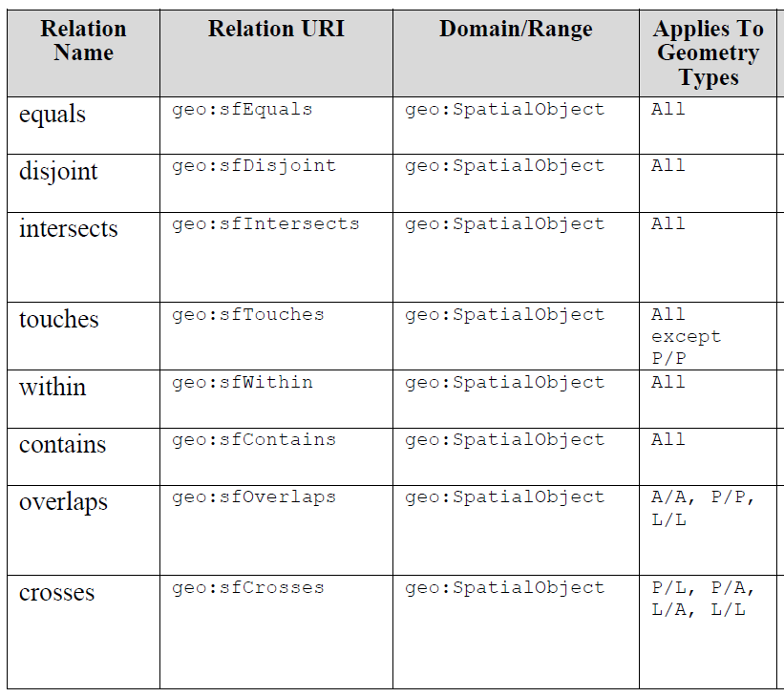
Simple features topological relations
From [1]
C. Métral
Semantic Web Technologies
30

Slide 31
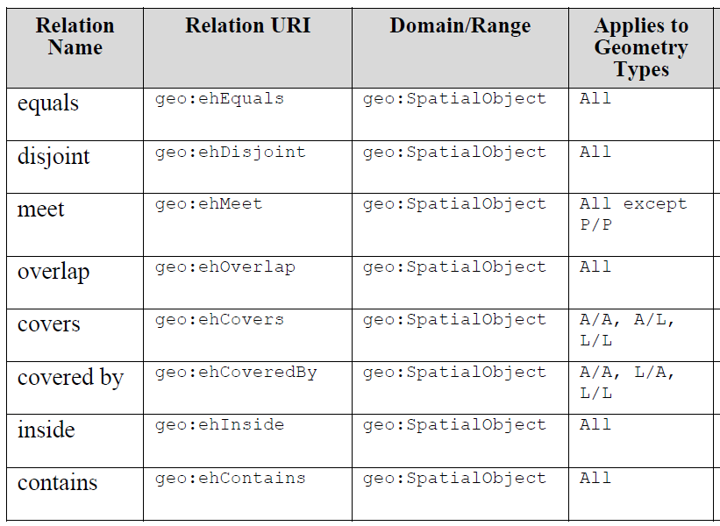
Egenhofer topological relations
From [1]
C. Métral
Semantic Web Technologies
31

Slide 32
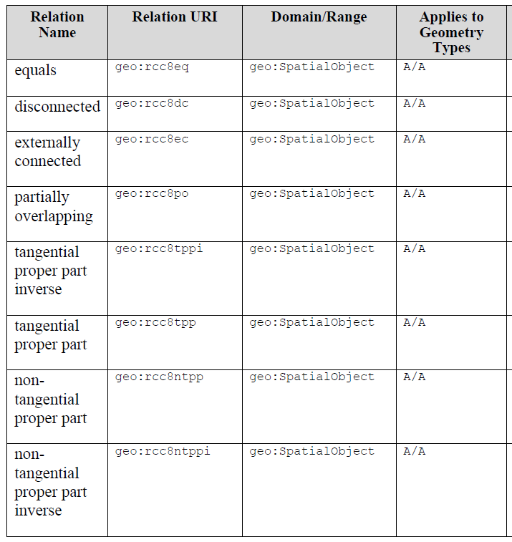
RCC8 topological relations
From [1]
C. Métral
Semantic Web Technologies
32

Slide 33
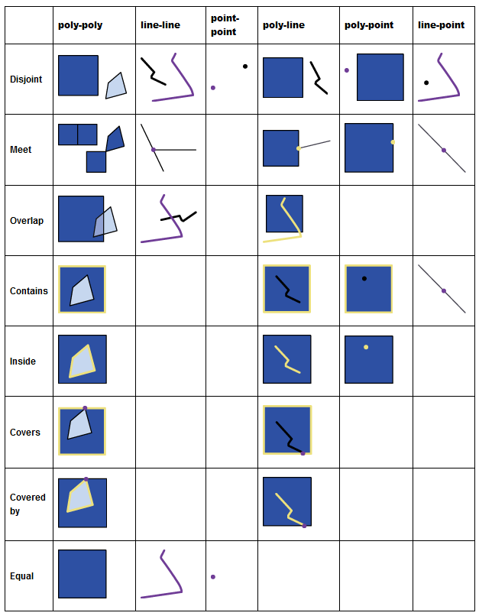
RCC8 topological relations
From http://www.gitta.info/SpatialQueries/en/html
From [1]
C. Métral
Semantic Web Technologies
33

Slide 34
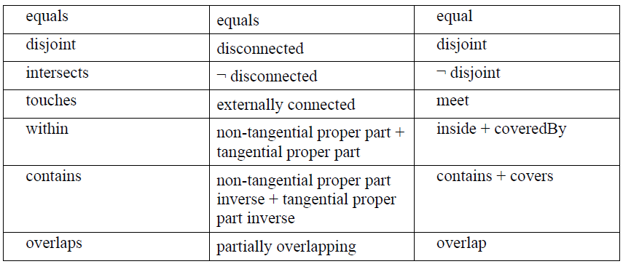
Equivalent RCC8, Egenhofer and Simple Features Topological Relations
From [1]
C. Métral
Semantic Web Technologies
34

Slide 35
Example of a query
Find the monuments that are within ex:Park1
PREFIX geo: <http://www.opengis.net/def/geosparql/>
PREFIX ex: <http://cui.unige.ch/>
SELECT ?f
WHERE {
ex:Park1 geo:hasGeometry ?g1 .
?f a ex:Monument;
geo:hasGeometry ?g2 .
?g2 geo:sfWithin ?g1 .
}
-> ex:Monument1
From [2]
C. Métral
Semantic Web Technologies
35

Slide 36
GeoSPARQL query functions
As topological relationships but use the prefix geof instead of geo: for example, geof:sfEquals (and not anymore geo:sfEquals)
Returns true or false instead of a geometry as it is with the topological relations
C. Métral
Semantic Web Technologies
36

Slide 37
Example of a query
Find whether there are monuments that are within ex:Park1
PREFIX geo: <http://www.opengis.net/def/geosparql/>
PREFIX geof: <http://www.opengis.net/def/function/geosparql/>
PREFIX ex: <http://cui.unige.ch/>
SELECT ?f
WHERE {
ex:Park1 geo:hasGeometry ?g1 .
?f a ex:Monument;
geo:hasGeometry ?g2 .
?g2 geof:sfWithin ?g1 .
}
-> true
From [2]
C. Métral
Semantic Web Technologies
37

Slide 38
Other query functions
Properties | Parameters | Returns
geof:distance | Geom1, Geom2, unitsURI | xsd:double
geof:buffer | Geom1, radius, unitsURI | Geometry literal
geof:convexHull | Geom1 | Geometry literal
geof:intersection | Geom1, Geom2 | Geometry literal
geof:union | Geom1, Geom2 | Geometry literal
geof:difference | Geom1, Geom2 | Geometry literal
geof:symDifference | Geom1, Geom2 | Geometry literal
geof:envelope | Geom1 | Geometry literal
geof:boundary | Geom1 | Geometry literal
geof:getsrid | Geom1 | SRID of literal
…
From [2]
C. Métral
Semantic Web Technologies
38

Slide 39
Query Transformation Rules
Allow for an additional layer of abstraction in SPARQL queries
If a feature is used as the subject or object of a topological relation, the query is automatically rewritten to compare the geometry linked, thus removing the abstraction for processing
Before: … SELECT ?f
WHERE {
?f a ex:Monument;
?f geo:sfWithin ex:Park1.
}
From [4]
C. Métral
Semantic Web Technologies
39

Slide 40
Query Transformation Rules
After: …
SELECT ?f
WHERE {
ex:Park1 geo:hasGeometry ?g1 .
?f a ex:Monument;
geo:hasGeometry ?g2 .
?g2 geo:sfWithin ?g1 .
}
From [2]
C. Métral
Semantic Web Technologies
40

Slide 41
Implementation: some sites
Some triple store implementations that can spatially index information in the vocabulary, and perform spatial reasoning
AllegroGraph for geospatial and temporal reasoning
https://franz.com/agraph/allegrograph/
Stardog https://www.stardog.com https://www.stardog.com/docs/java/snarl/com/complexible/stardog/spatial/geosparql
Strabon spatiotemporal RDF store with a subset of GeoSPARQL
https://strabon.di.uoa.gr
C. Métral
Semantic Web Technologies
41

Slide 42
Implementation: some sites
GraphDB limited custom geospatial queries possible over WGS84 data (GraphDBfunctions)
GeoSPARQL sites (Online queries)
http://www.geosparql.org/
http://linkedgeodata.org/sparql
C. Métral
Semantic Web Technologies
42

Slide 43
On GraphDB
Usage
Plugin control predicates
Enable plugin with PREFIX : <http://www.ontotext.com/plugins/geosparql#> INSERT DATA { _:s :enabled "true" . }
Disable plugin with PREFIX : <http://www.ontotext.com/plugins/geosparql#> INSERT DATA { _:s :enabled "false" . }
Note that
When the plugin is disabled, it does not index any data or process updates. It does not handle any of the GeoSPARQL predicates either
All GeoSPARQL functions starting with geof: like geof:sfOverlaps do not use any indexes and are always enabled
C. Métral
Semantic Web Technologies
43

Slide 44
Some references
[1] OGC GeoSPARQL – A Geographic Query Language for RDF Data, Open Geospatial Consortium, OGC 11-052r4 http://www.opengis.net/doc/IS/geosparql/1.0
[2] GeoSPARQL user guide, Dave Kolas & Robert Battle, 1/19/2012
[3] Getting started with GeoSPARQL, Dave Kolas, Matt Perry & John Herring, OGC, Oct 29 2013 http://www.ssec.wisc.edu/meetings/geosp_sem/presentations/GeoSPARQL_Getting_Started%20-%20KolasWorkshop%20Version.pdf
[4] GeoSPARQL: Enabling a Geospatial Semantic Web, Robert Battle, Dave Kolas http://www.semantic-web-journal.net/sites/default/files/swj176_0.pdf
C. Métral
Semantic Web Technologies
44

Slide 45
Some references
W3C Geospatial Ontologies
http://www.w3.org/2005/Incubator/geo/XGR-geo-ont/
Geonames interface http://www.geonames.org/
Vocabularies for geospatial modelling http://geovocab.org/
Basic Geo (WGS84 lat/long) Vocabulary
https://www.w3.org/2003/01/geo/
C. Métral
Semantic Web Technologies
45

Slide 46
Annex: acronyms
GeoJSON Geographic JavaScript Object Notation
GFM General Feature Model (as defined in ISO 19109)
GML Geography Markup Language
KML Keyhole Markup Language
OWL OWL 2 Web Ontology Language
RCC Region Connection Calculus
RDF Resource Description Framework
RDFS RDF Schema
RIF Rule Interchange Format
SPARQL SPARQL Protocol and RDF Query Language
WKT Well Known Text (as defined by Simple Features or ISO 19125)
W3C World Wide Web Consortium (http://www.w3.org/)
XML Extensible Markup Language
From [1]
C. Métral
Semantic Web Technologies
46

Slide 47
Annex: XML namespaces
geo: http://www.opengis.net/ont/geosparql#
geof: http://www.opengis.net/def/function/geosparql/
geor: http://www.opengis.net/def/rule/geosparql/
gml: http://www.opengis.net/ont/gml#
owl: http://www.w3.org/2002/07/owl#
rdf: http://www.w3.org/1999/02/22-rdf-syntax-ns#
rdfs: http://www.w3.org/2000/01/rdf-schema#
sf: http://www.opengis.net/ont/sf#
xsd: http://www.w3.org/2001/XMLSchema#
From [1]
C. Métral
Semantic Web Technologies
47

Slide 48
Annex: Turtle prefixes
@prefix rdf: <http://www.w3.org/1999/02/22-rdf-syntax-ns#> . @prefix rdfs: <http://www.w3.org/2000/01/rdf-schema#> . @prefix xsd: <http://www.w3.org/2001/XMLSchema#> .
@prefix geo: <http://www.opengis.net/ont/geosparql#> .
@prefix geof: < http://www.opengis.net/def/function/geosparql/> . @prefix geor: < http://www.opengis.net/def/rule/geosparql/> . @prefix sf: < http://www.opengis.net/ont/sf# > . @prefix gml: < http://www.opengis.net/ont/gml# > .
@prefix owl: < http://www.w3.org/2002/07/owl#> .
From [1]
C. Métral
Semantic Web Technologies
48

Slide 49
Annex: SPARQL prefixes
PREFIX rdf: <http://www.w3.org/1999/02/22-rdf-syntax-ns#> PREFIX rdfs: <http://www.w3.org/2000/01/rdf-schema#> PREFIX xsd: <http://www.w3.org/2001/XMLSchema#>
PREFIX geo: <http://www.opengis.net/ont/geosparql#> PREFIX geof: <http://www.opengis.net/def/function/geosparql/> PREFIX geor: <http://www.opengis.net/def/rule/geosparql/>
PREFIX sf: <http://www.opengis.net/ont/sf#> PREFIX gml: <http://www.opengis.net/ont/gml#>
PREFIX owl: <http://www.w3.org/2002/07/owl#>
From [1]
C. Métral
Semantic Web Technologies
49

Slide 50
Annex: SPARQL prefixes
PREFIX geo: <http://www.w3.org/2003/01/geo/wgs84_pos#>
PREFIX gn: http://www.geonames.org/ontology#
PREFIX geom: <http://geovocab.org/geometry#>
PREFIX spatial: <http://geovocab.org/spatial#>
PREFIX loticoowl: <http://www.lotico.com/ontology/>
PREFIX my: <http://example.org/ApplicationSchema#>
From [1]
C. Métral
Semantic Web Technologies
50

